Slide 1
Healthcare Appointment No-Shows Prediction Dataset
-Tejasvini Shinde.

Slide 2
PROBLEM STATEMENT
This dataset contains data on whether someone would showed up for a medical appointment or not. 107K rows and 15 columns, 1 target variable: Showed Up substantial enough to train a machine learning model. We can use this data to predict whether someone would show up for a healthcare appointment or not.
Dependant Variable :- Showed Up – An Boolean representing whether someone would show up for a healthcare appointment or not.

Slide 3
FLOW DIAGRAM OF THE PROJECT
Data Collection
Data Cleaning
Data Preprocessing
Model Data Frame – 1
Exploratory Data Analysis(EDA)
Class Imbalance/ Outlier/Skewness
Model Building
Model Data Frame -2
Feature Selection
Final Data Frame
Cross Validation
Best Model

Slide 4
DATA AND CLEANING :-
Data Contain 107K Observations and 15 Attributes.
Showed_up Columns is Target Variable.
Missing Value Treatment :- There is No missing value in dataset.
Converting Data Types . Using LabelEncoder.
Rename Date.diff column.

Slide 5
REPORT-1 AND CONCLUSION
 | Model Name | Accuracy | Precision | Recall | F1-Score
1 | Logistic Regression | 79.568184 | 0.992162 | 0.800104 | 0.885843
2 | Decision Tree | 74.422843 | 0.862140 | 0.825493 | 0.843418
3 | Random Forest | 76.507150 | 0.907352 |  | 0.860566
4 | KNN | 79.437331 | 0.985670 | 0.802209 | 0.884527
5 | SVM | 79.899991 | 0.000000 | 0.000000 | 0.000000
6 | Naive Bayes |  |  | 0.848585 | 0.807202
0.818369
70.623423
0.769667
Conclusion :- From above Table Logistic Regression is best fitted model .

Slide 6
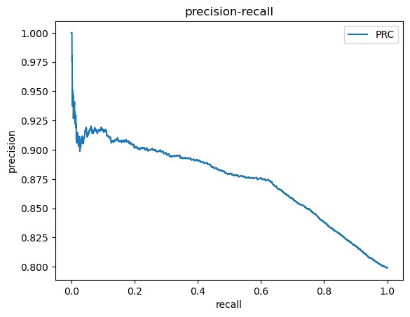
GRAPH OF BEST FITTED MODEL
PRC Curve
Conclusion :- Best fitted Model is Logistic Regression.

Slide 7
EDA :-
Visualization
Class Imbalance Treatment - Nearmiss
Outlier Treatments
Skewness Treatment – SquareRoot Transformation

Slide 8
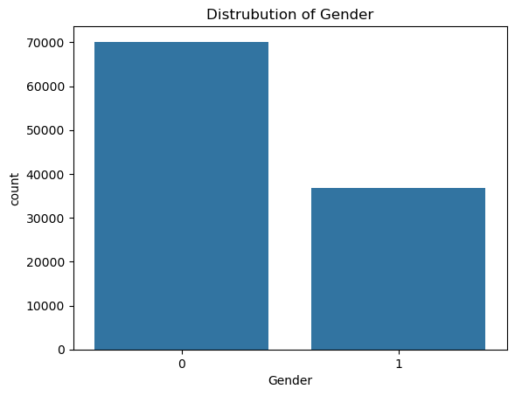
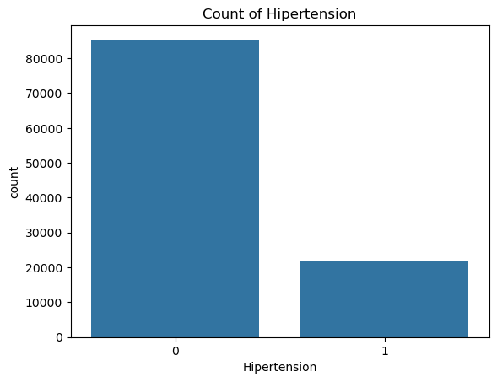
VISUALIZATIONS
Conclusion:-Distribution of Male and Female Patients.
Conclusion:-Distribution of Patients with and without Hypertension.

Slide 9
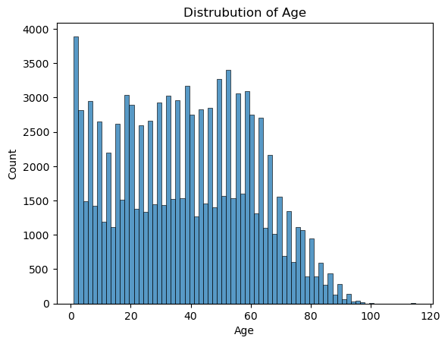
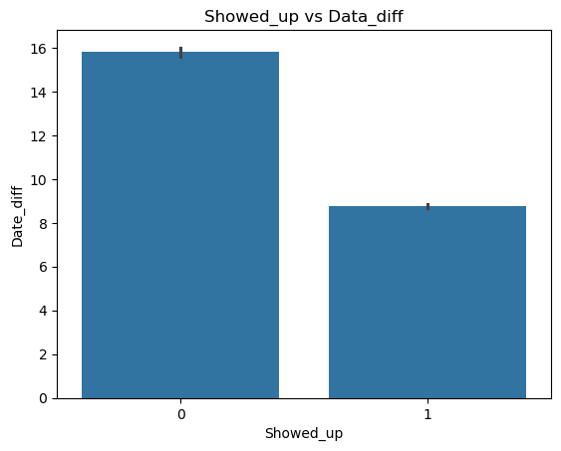
VISUALIZATIONS
Conclusion:- distribution of patient ages, highlighting which age groups are most prevalent in the healthcare appointment data.
Conclusion:- bar plot shows relationship between whether a patient showed up for their appointment and the average number of days between scheduling and the appointment.

Slide 10
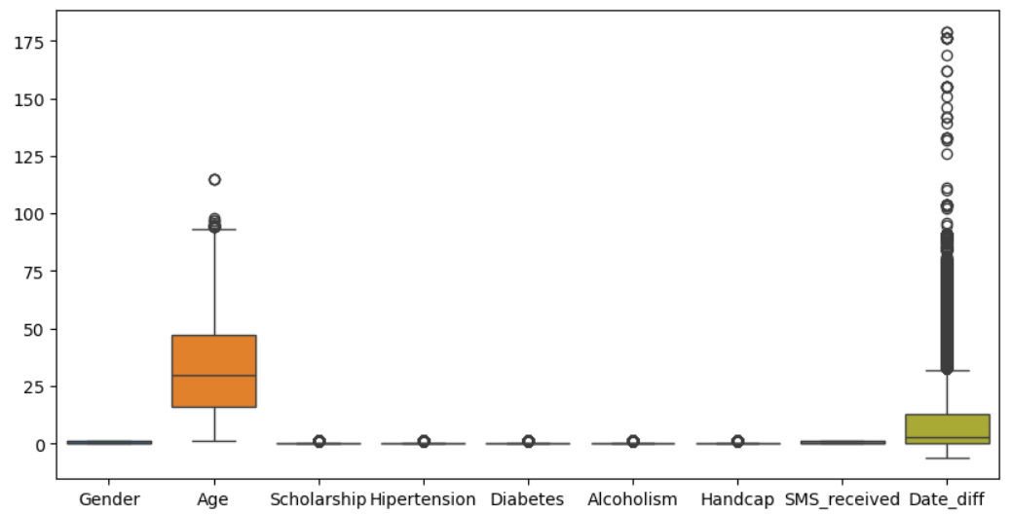
OUTLIERS

Slide 11
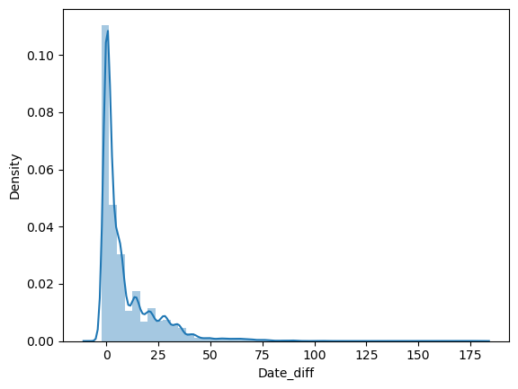
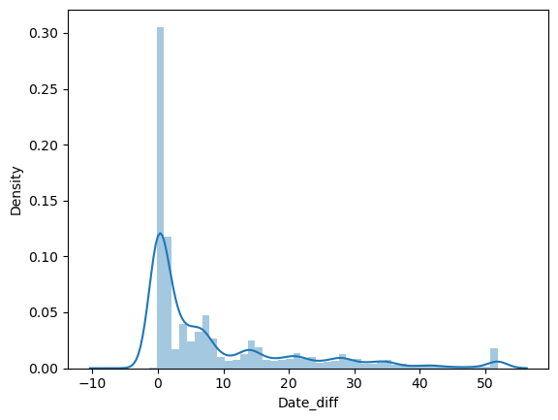
OUTLIERS TREATMENT
Date_diff before outlier.
Date_diff after outlier.

Slide 12
REPORT-2 AND CONCLUSION
 | Model Name | Accuracy | Precision | Recall | F1-Score
1 | Logistic Regression | 79.139760 | 0.871801 | 0.748651 | 0.805547
2 | Decision Tree | 80.523524 | 0.865752 | 0.769915 | 0.815026
3 | Random Forest | 80.696494 | 0.880875 | 0.765158 | 0.818949
4 | KNN | 80.119926 | 0.848302 | 0.772785 | 0.808784
5 | SVM | 79.289668 | 0.000000 | 0.000000 | 0.000000
7 | Naive Bayes | 74.423432 | 0.849465 | 0.699157 | 0.767017
7 | XGBoost | 81.918819 | 0.869009 | 0.787975 | 0.826510
Conclusion:- From above Table we have XGBoost are best fitted from other models.

Slide 13
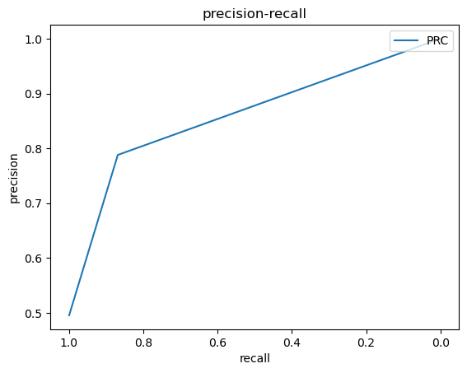
GRAPH OF BEST FITTED MODEL
PRC Curve
Conclusion:- Best Fitted Model is XGBoost.

Slide 14
REPORT-3 AND CONCLUSION
 | MODEL NAME | ACCURACY | PRECISION | RECALL | F1-SCORE
1 | RANDOM FOREST | 80.362085 | 0.764095 | 0.764095 | 0.764095
2 | XGBOOST | 81.492159 | 0.857143 | 0.788021 | 0.821130
Conclusion:- From above Table XGBoost is the best Model.

Slide 15

GRAPH OF BEST FITTED MODEL
PRC Curve
Conclusion:- Best Fitted Model is XGBoost.

Slide 16
CROSS VALIDATION AND CONCLUSION
Stratified KFold Accuracy is :0.80
The model works well, with an average accuracy of about 80%. The low variation in the Stratified KFold results shows that the model performs consistently across different parts of the data. Overall, you can trust that the model's performance is stable and reliable.

Slide 17
DRAWBACK OF DATSET
This dataset contains information about patient appointments, including details such as age, gender, health conditions, and whether patients showed up for their appointments. However, there are several drawbacks to consider:
Data Quality: Some columns may have formatting issues or missing values, which could affect our analysis.
Outliers: The age range includes very young patients, which might not be typical for this type of data.
Imbalance: The number of patients who did not show up for appointments could be significantly higher than those who did, impacting predictive models.
Context: The data is from 2016, which may not reflect current trends, and lacks some important contextual health information.
Privacy: Patient identifiers should be handled carefully to protect privacy.
Overall, while the dataset provides useful insights into patient appointments, addressing these issues is crucial for accurate analysis and decision-making.

Slide 18
THANK YOU !!

